Slide 1
SICT
Andreas Pangestu Lim
2001540116
Andrew
2001554166
Jonathan
2001540116
Simple Image Classifier using Tensorflow

Slide 2

Object Detection
How computer detects objects in image/video

Slide 3
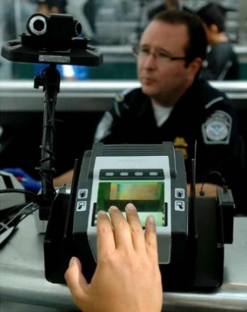
Object Recognition
How computer recognizes objects in image/video

Slide 4
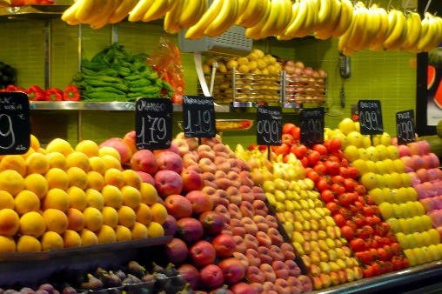
Why Object Detection / Recognition Is Important
Object Detection / Recognition separates image processing with computer vision

Slide 5
Three Principles in Object Detection / Recognition
Image Processing
Feature Extraction
Classification

Slide 6
Machine Learning Enables computer to learn using data without explicit programming
Types:
Supervised Learning
Unsupervised Learning
A Method for Object Recognition:
Convolutional Neural Networks (CNN)

Slide 7
Algorithm
Retrain model
Get and download image URL
Label the image
Ask user for confirmation
If incorrect label, download resources for retraining

Slide 8
Algorithm
Retraining
Labelling Image

Slide 9
Demonstration

Slide 10
Thank You

